Slide 1
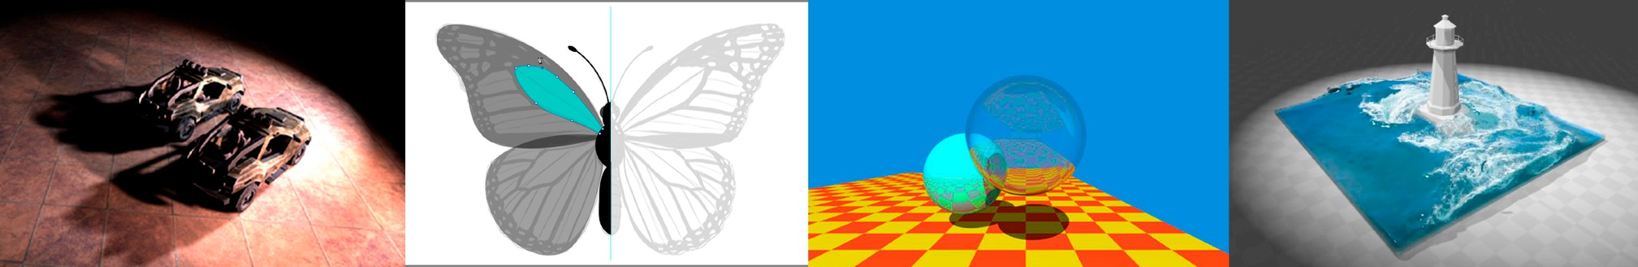
Introduction to Computer Graphics
Lecture 8:
Shading 2
(Shading, Pipeline and Texture Mapping)
http://www.cs.ucsb.edu/~lingqi/teaching/games101.html

Slide 2



Last Lecture
Shading 1
- Blinn-Phong reflectance model
-
-
-
Diffuse Specular Ambient
^
^_{n}
l
_{v}^
8
-
At a specific shading point

Slide 3
Today
Shading 2
- Blinn-Phong reflectance model
- Specular and ambient terms Shading frequencies
Graphics pipeline Texture mapping Barycentric coordinates
-
-
-
-

Slide 4

Recap: Lambertian (Diffuse) Term
Shading independent of view direction
energy arrived
at the shading point
l
n
L_{d} = k_{d} (I/r²) max(0, n · l)
8
v
diffuse coefficient (color)
energy received by the shading point
diffusely reflected light

Slide 5
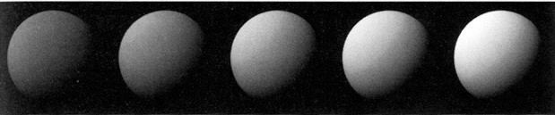
Recap: Lambertian (Diffuse) Term
Produces diffuse appearance
[Foley et al.]
k_{d}

Slide 6
Specular Term (Blinn-Phong)
Intensity depends on view direction
Bright near mirror reflection direction
R
l
n
v

Slide 7

Specular Term (Blinn-Phong)
V close to mirror direction ⇔ half vector near normal
Measure “near” by dot product of unit vectors
h = bisector(v, l)
v + l
h
α
=
||v + l||
l
n
v
L_{s} = k_{s} (I/r²) max(0, cos a)^{p}
= k_{s} (I/r²) max(0, n · h)^{p}
specularly reflected light
specular coefficient

Slide 8
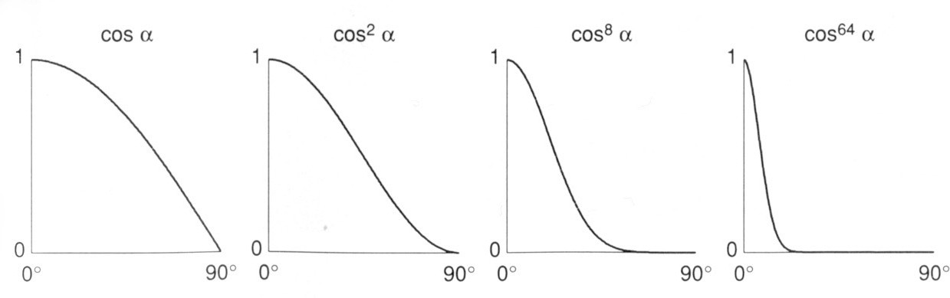
Cosine Power Plots
Increasing p narrows the reflection lobe
[Foley et al.]

Slide 9
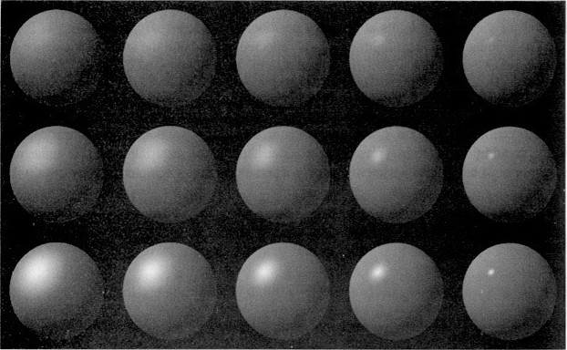
Specular Term (Blinn-Phong)
Blinn-Phong
L_{s} = k_{s} (I/r²) max(0, n · h)^{p}
[Foley et al.]
k_{s}
Note: showing Ld + Ls together
p

Slide 10
Ambient Term
Shading that does not depend on anything
Add constant color to account for disregarded illumination and fill in black shadows
This is approximate / fake!
L_{a} = k_{a} I_{a}
ambient coefficient
reflected ambient light

Slide 11
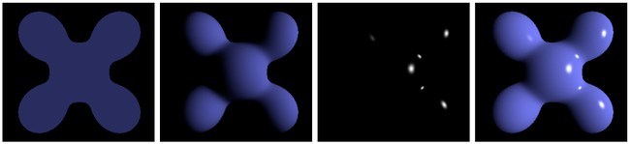
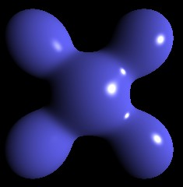
Blinn-Phong Reflection Model
Blinn-Phong Reflection
Ambient +
Diffuse
+ Specular =
L = L_{a} + L_{d} + L_{s}
= k_{a} I_{a} + k_{d} (I/r²) max(0, n · l) + k_{s} (I/r²) max(0, n · h)^{p}

Slide 12
Questions?

Slide 13
Shading Frequencies

Slide 14

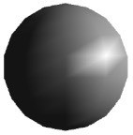
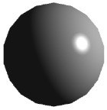
Shading Frequencies
What caused the shading difference?

Slide 15
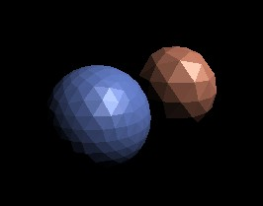
Shade each triangle (flat shading)
Flat shading
Triangle face is flat — one normal vector
Not good for smooth surfaces

Slide 16
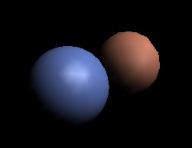
Shade each vertex (Gouraud shading)
Gouraud shading
Interpolate colors from vertices across triangle
Each vertex has a normal vector (how?)

Slide 17
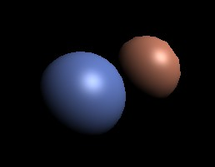
Shade each pixel (Phong shading)
Phong shading
Interpolate normal vectors across each triangle
Compute full shading model at each pixel
Not the Blinn-Phong Reflectance Model

Slide 18

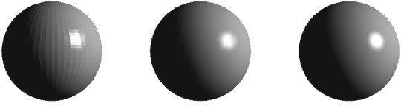
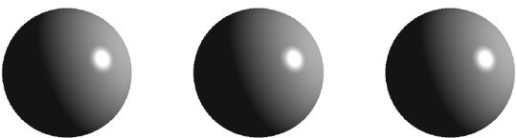
Shading Frequency: Face, Vertex or Pixel
Num Vertices
Shading freq. : Shading type :
Face Flat
Vertex Gouraud
Pixel Phong
Image credit: Happyman, http://cg2010studio.com/

Slide 19
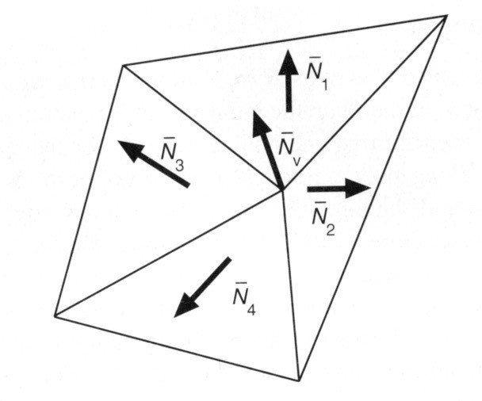
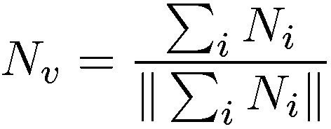
Defining Per-Vertex Normal Vectors
Best to get vertex normals from the underlying geometry
e.g. consider a sphere
Otherwise have to infer vertex normals from triangle faces
Simple scheme: average surrounding face normals

Slide 20

Defining Per-Pixel Normal Vectors
Barycentric interpolation (introducing soon) of vertex normals
Don’t forget to normalize the interpolated directions

Slide 21
Graphics (Real-time Rendering) Pipeline

Slide 22
Graphics Pipeline
3
Application
1
4
Input: vertices in 3D space
2
Vertex Processing
Vertex Stream
Vertices positioned in screen space
Triangle Processing
Triangle Stream
Triangles positioned in screen space
Rasterization
Fragment Stream
Fragments (one per covered sample)
Fragment Processing
Shaded Fragments
Shaded fragments
Framebuffer Operations
Display
Output: image (pixels)

Slide 23
Graphics Pipeline
Application
Vertex Processing
Model, View, Projection transforms
Vertex Stream
Triangle Processing
y
Triangle Stream
Rasterization
z
Fragment Stream
x
Fragment Processing
Shaded Fragments Framebuffer Operations
Display

Slide 24







Graphics Pipeline
Application
Vertex Processing
Sampling triangle coverage
Vertex Stream
Triangle Processing
Triangle Stream Rasterization
Fragment Stream Fragment Processing
Shaded Fragments Framebuffer Operations
Display

Slide 25
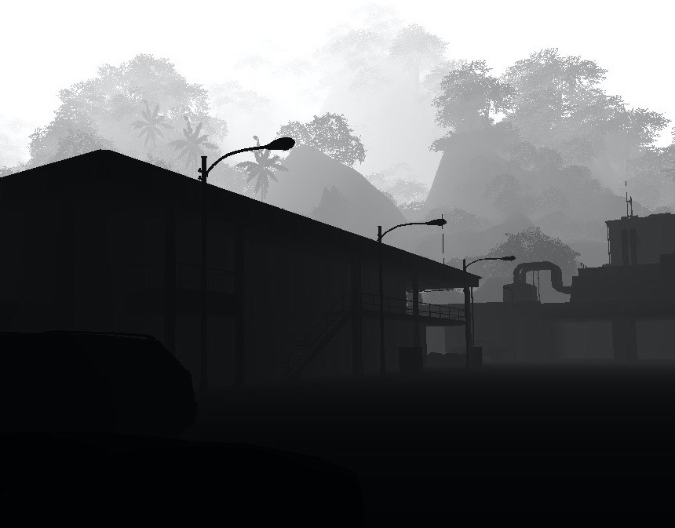
Rasterization Pipeline
Application
Vertex Processing
Z-Buffer Visibility Tests
Vertex Stream
Triangle Processing
Triangle Stream Rasterization
Fragment Stream Fragment Processing
Shaded Fragments Framebuffer Operations
Display

Slide 26
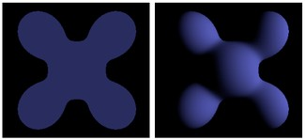
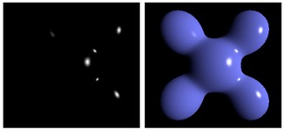
Graphics Pipeline
Application
Vertex Processing
Vertex Stream Triangle Processing
Triangle Stream Rasterization
Fragment Stream Fragment Processing
Shaded Fragments Framebuffer Operations
Shading
Ambient +
Diffuse
Display
+ Specular =
Blinn-Phong Reflectance Model

Slide 27
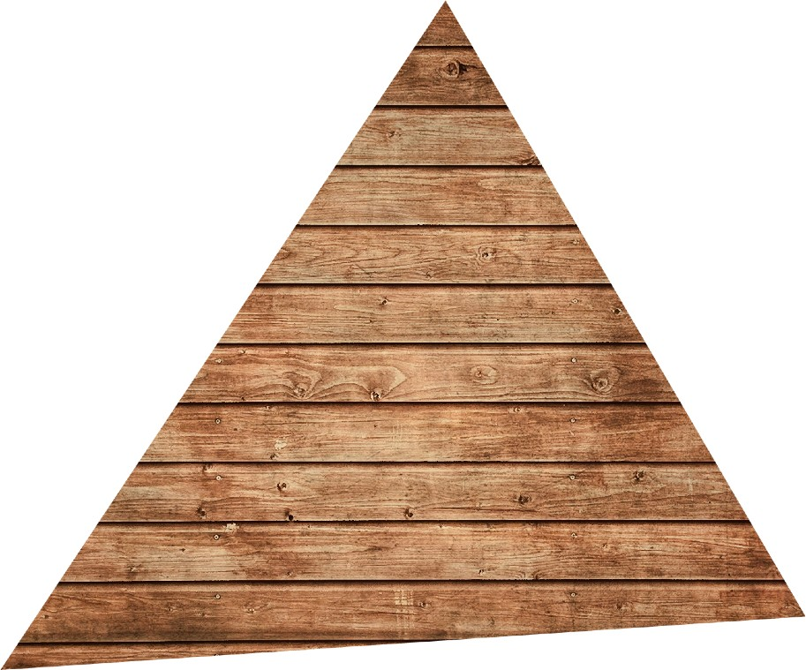
Graphics Pipeline
Application
Texture mapping (introducing soon)
Vertex Processing
Vertex Stream
Triangle Processing
Triangle Stream Rasterization
Fragment Stream Fragment Processing
Shaded Fragments Framebuffer Operations
Display

Slide 28


Shader Programs
Program vertex and fragment processing stages
Describe operation on a single vertex (or fragment)
Example GLSL fragment shader program
uniform sampler2D myTexture; uniform vec3 lightDir;
varying vec2 uv; varying vec3 norm;
void diffuseShader()
{
vec3 kd;
kd = texture2d(myTexture, uv);
kd *= clamp(dot(–lightDir, norm), 0.0, 1.0); gl_FragColor = vec4(kd, 1.0);
}
Shader function executes once per fragment.
Outputs color of surface at the current fragment’s screen sample position.
This shader performs a texture lookup to obtain the surface’s material color at this point, then performs a diffuse lighting calculation.

Slide 29


Shader Programs
Program vertex and fragment processing stages
Describe operation on a single vertex (or fragment)
Example GLSL fragment shader program
uniform sampler2D myTexture; uniform vec3 lightDir;
varying vec2 uv; varying vec3 norm;
// program parameter
// program parameter
// per fragment value (interp. by rasterizer)
// per fragment value (interp. by rasterizer)
void diffuseShader()
{
vec3 kd;
kd = texture2d(myTexture, uv);
kd *= clamp(dot(–lightDir, norm), 0.0, 1.0); gl_FragColor = vec4(kd, 1.0);
}
// material color from texture
// Lambertian shading model
// output fragment color

Slide 30
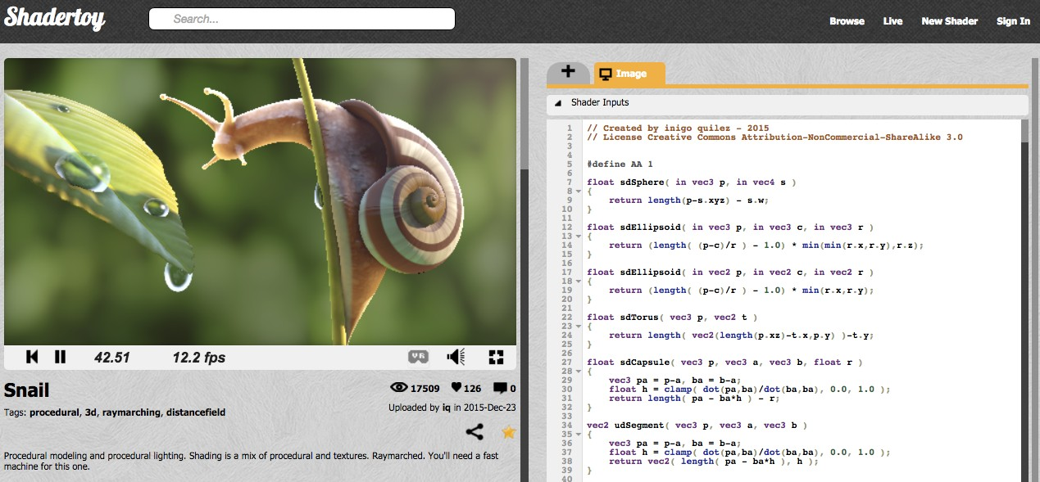
Snail Shader Program
Inigo Quilez
Procedurally modeled, 800 line shader. http://shadertoy.com/view/ld3Gz2
31

Slide 31
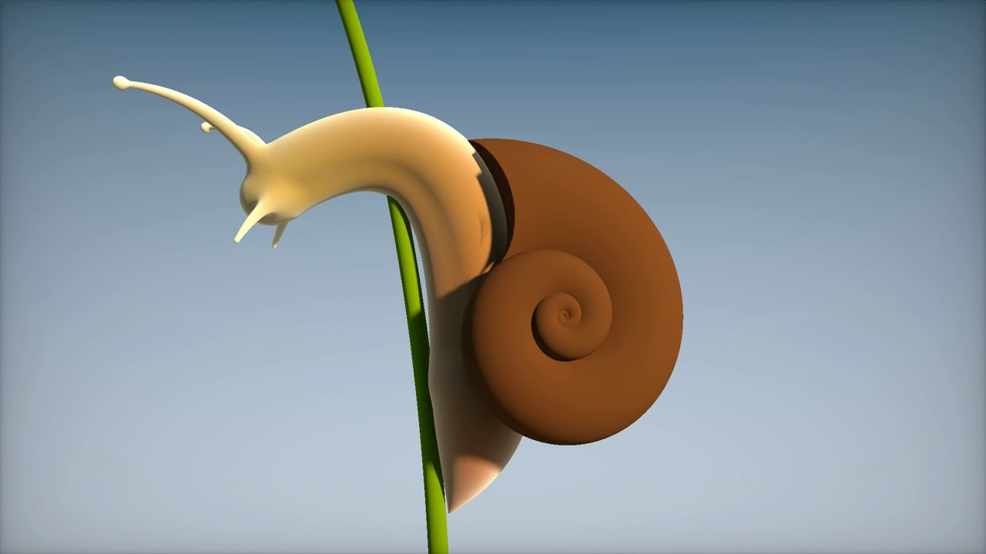
Snail Shader Program
Inigo Quilez, https://youtu.be/XuSnLbB1j6E

Slide 32



Goal: Highly Complex 3D Scenes in Realtime
100’s of thousands to millions of triangles in a scene
Complex vertex and fragment shader computations
High resolution (2-4 megapixel + supersampling)
30-60 frames per second (even higher for VR)
Unreal Engine Kite Demo (Epic Games 2015)

Slide 33
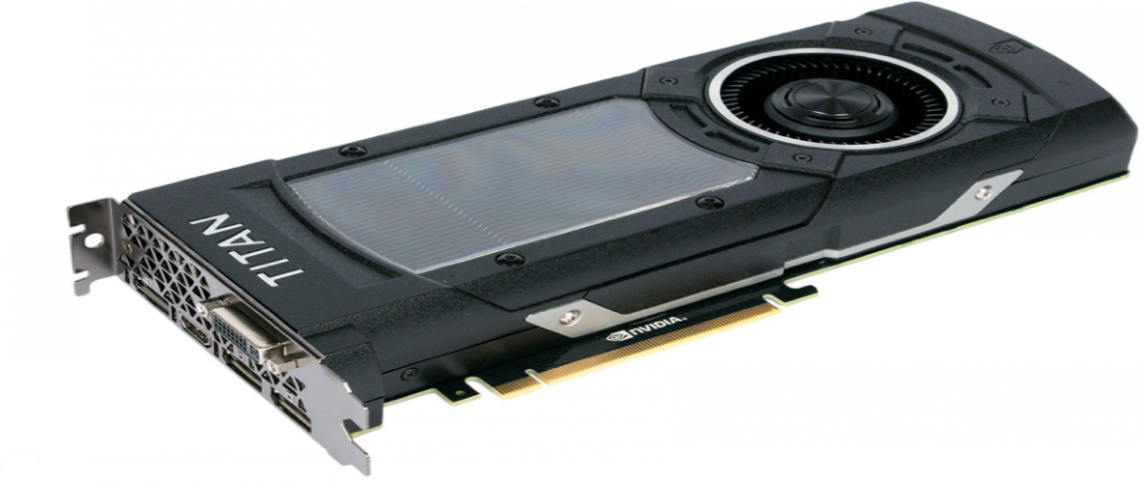
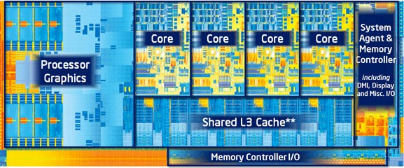
Graphics Pipeline Implementation: GPUs
Specialized processors for executing graphics pipeline computations
Discrete GPU Card (NVIDIA GeForce Titan X)
Integrated GPU: (Part of Intel CPU die)
34

Slide 34
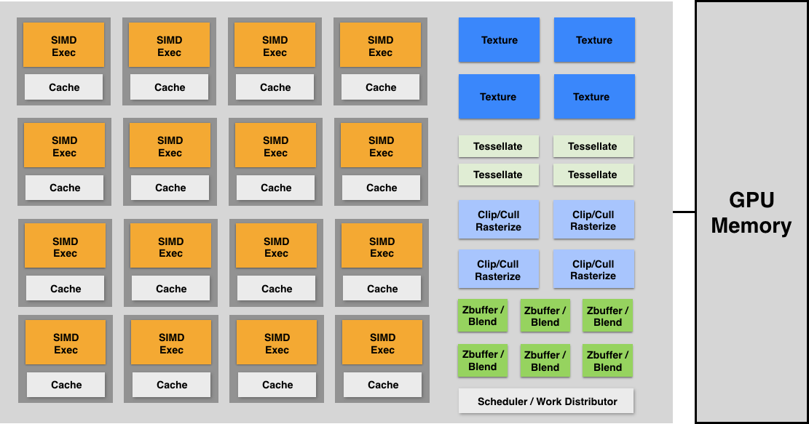
GPU: Heterogeneous, Multi-Core Procesor
Modern GPUs offer ~2-4 Tera-FLOPs of performance for executing vertex and fragment shader programs
Tera-Op’s of fixed-function compute capability over here

Slide 35
Texture Mapping

Slide 36
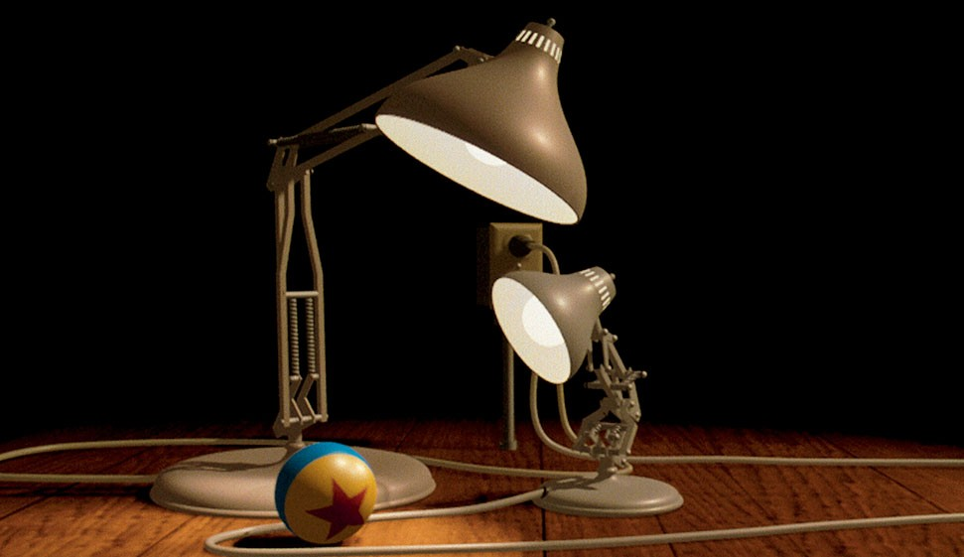


Different Colors at Different Places?
L_d = k_d * (I / r^2) * (n dot l)
Pattern on ball
Wood grain on floor

Slide 37
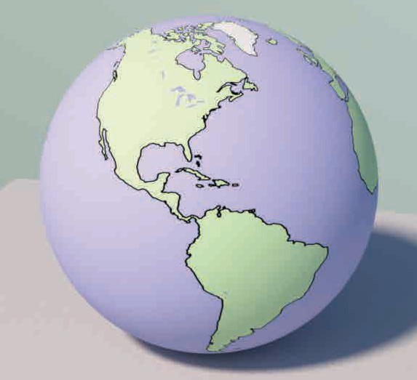
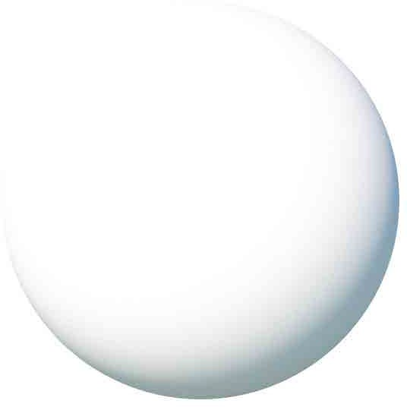
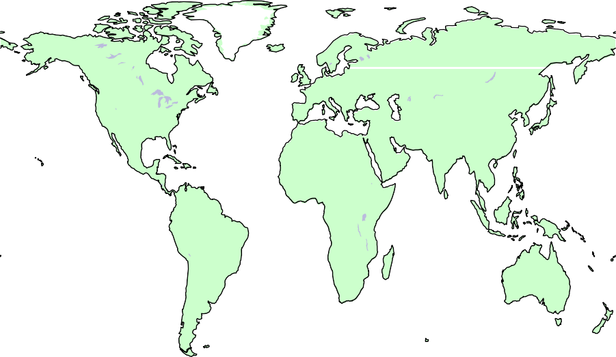

Surfaces are 2D
Surface lives in 3D world space
Every 3D surface point also has a place where it goes in the 2D image (texture).
rr
cp
y
x
y_{s}
v
x_{s}
z
u
Screen space
World space
Texture space

Slide 38
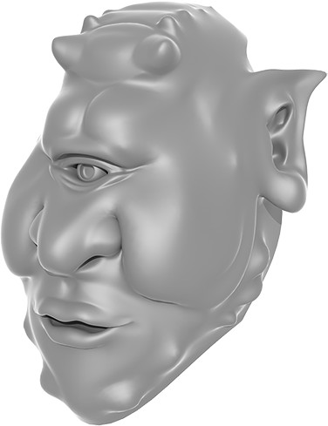
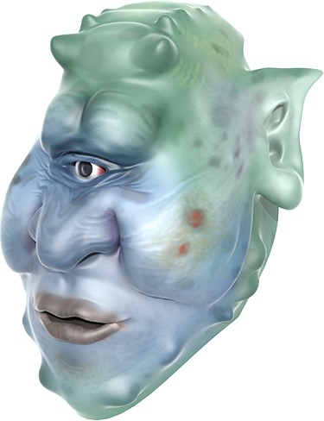
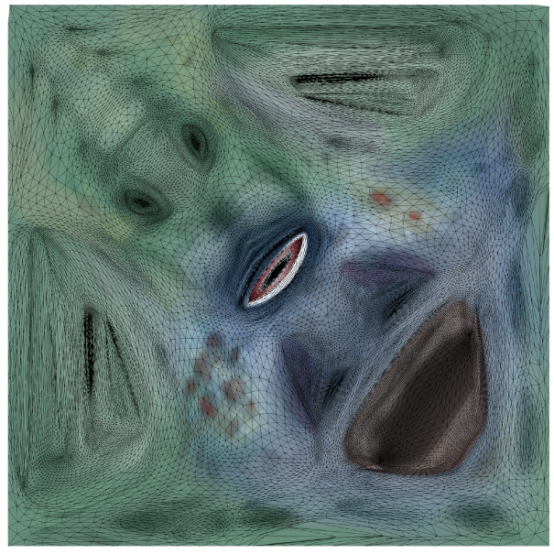
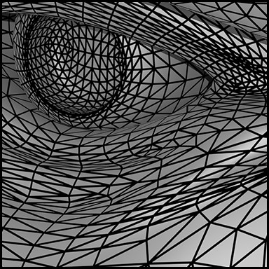
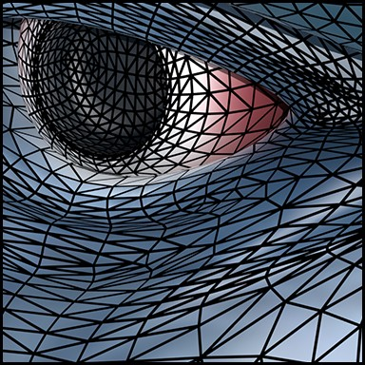
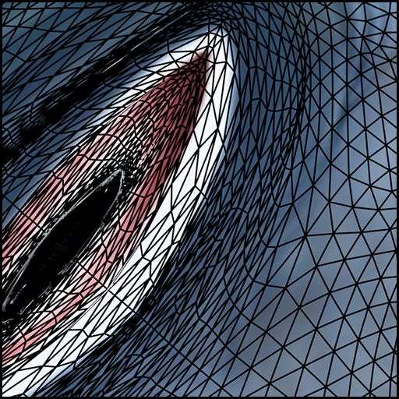
Texture Applied to Surface
Rendering without texture
Rendering with texture
Texture
Zoom
Each triangle “copies” a piece of the texture image to the surface.

Slide 39
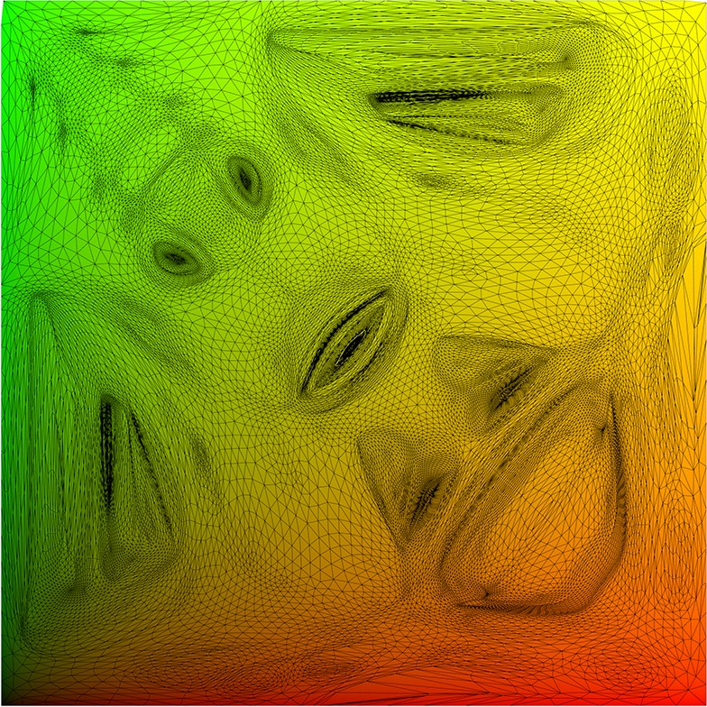
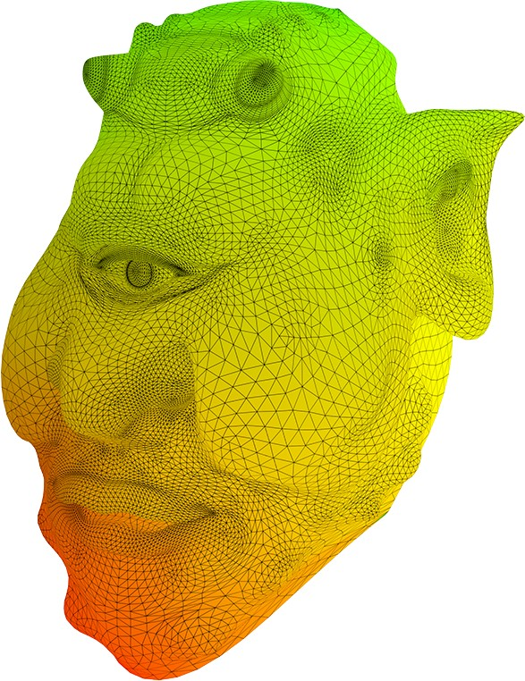
Visualization of Texture Coordinates
Each triangle vertex is assigned a texture coordinate (u,v)
v
Triangle vertices in texture space
Visualization of texture coordinates
u

Slide 40
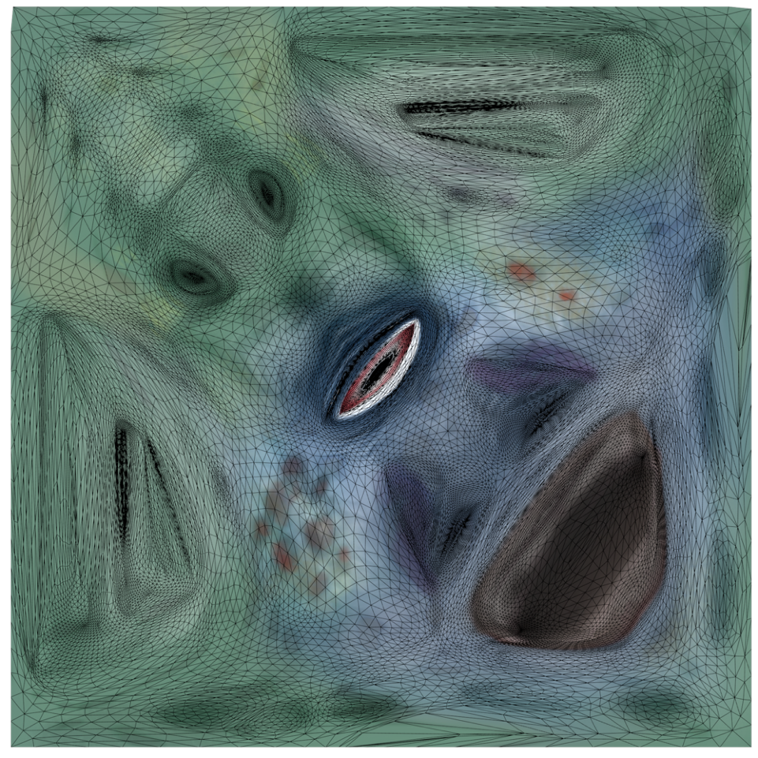
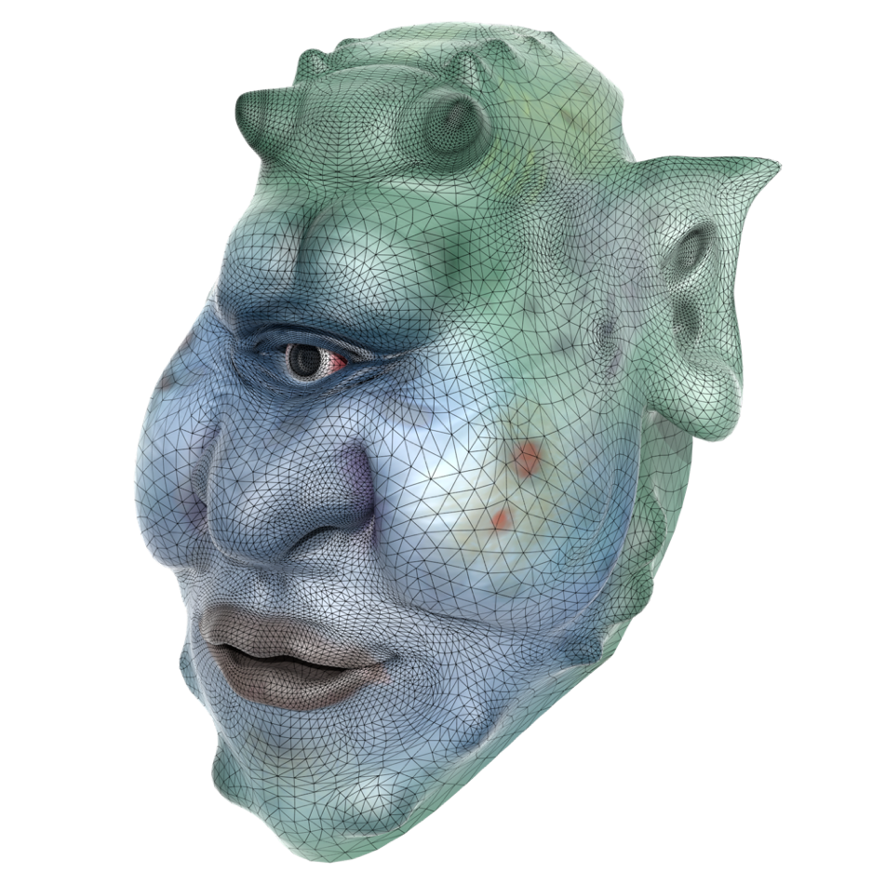
Texture Applied to Surface
Rendered result
Triangle vertices in texture space
v
u

Slide 41
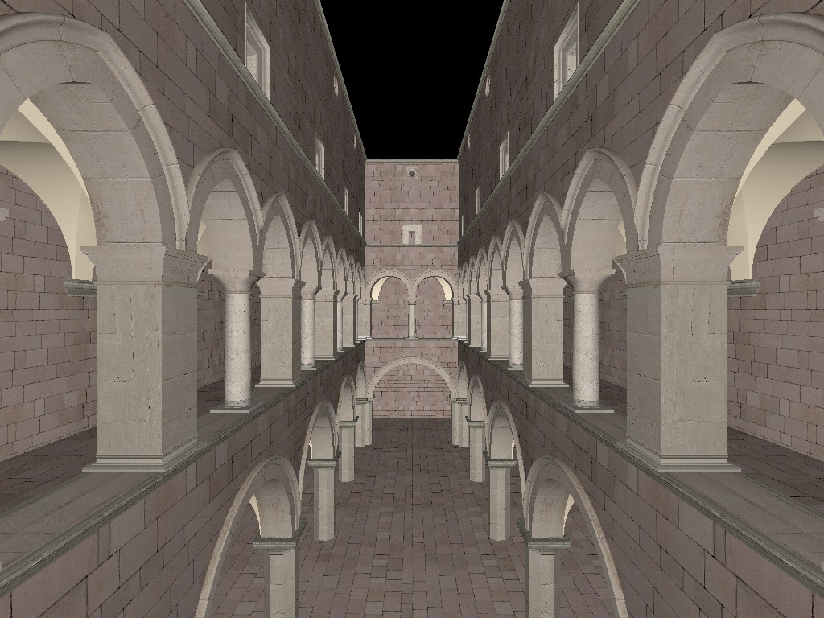
Textures applied to surfaces

Slide 42
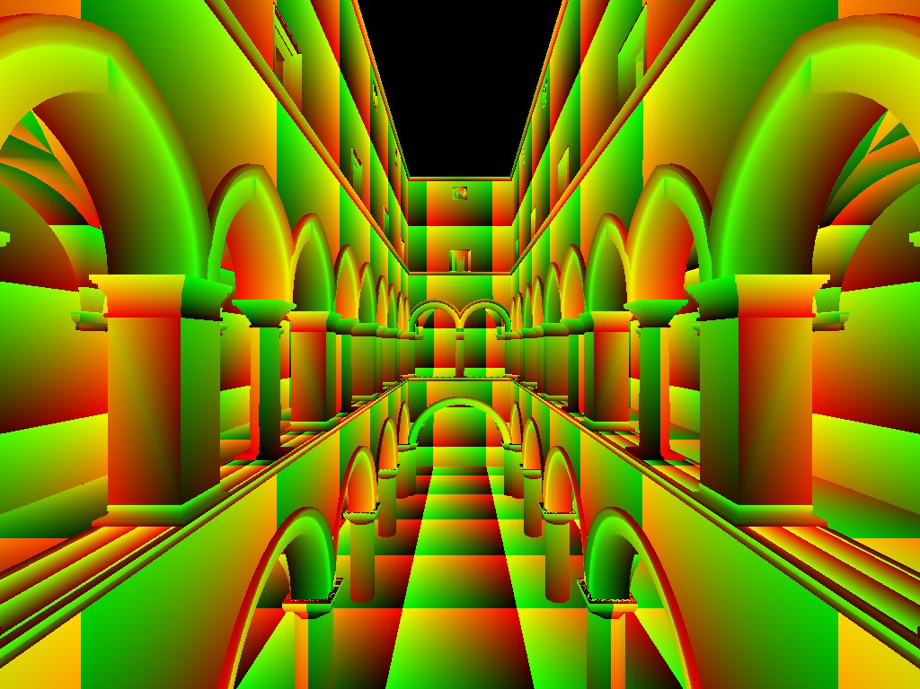
Visualization of texture coordinates

Slide 43


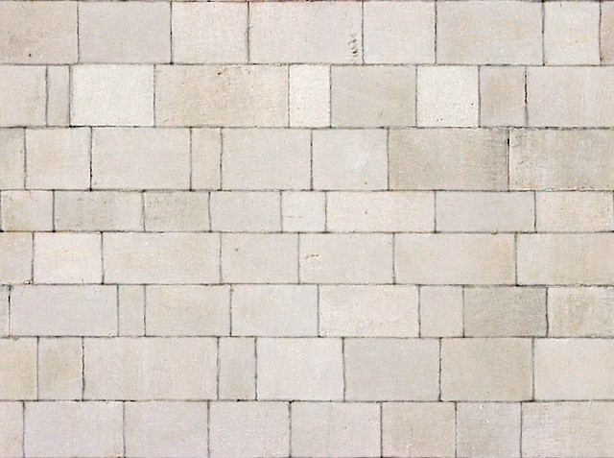
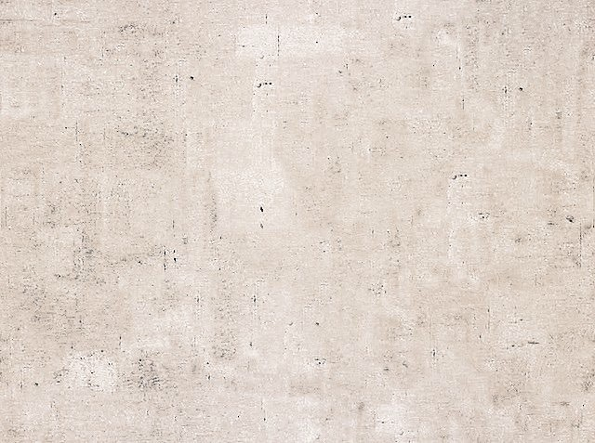



Textures can be used multiple times!
example textures used / tiled

Slide 44
Thank you!
(And thank Prof. Ravi Ramamoorthi, Prof Lingqi Yan and Prof. Ren Ng for many of the slides!)

